Slide 1
Microsoft AI Ecosystem
Unauthoritative Conceptual Infographic.
V1.51 10/03/2024
https://github.com/Pokeystuff/MSAIEcosystem

Slide 2










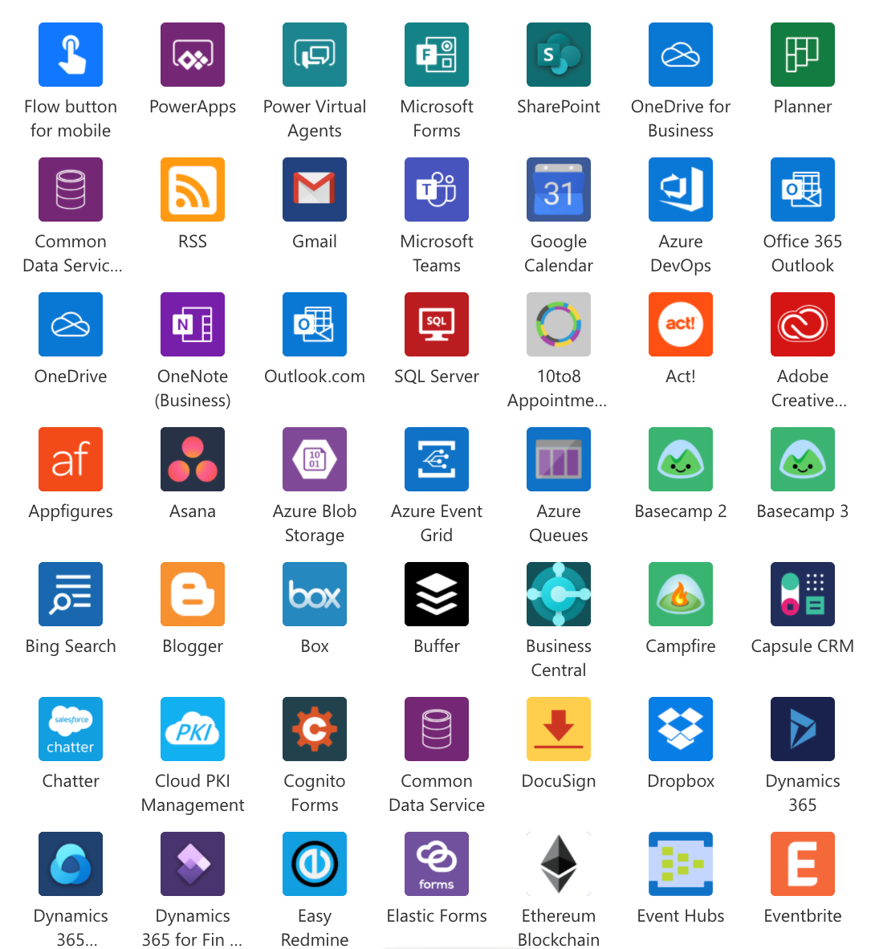

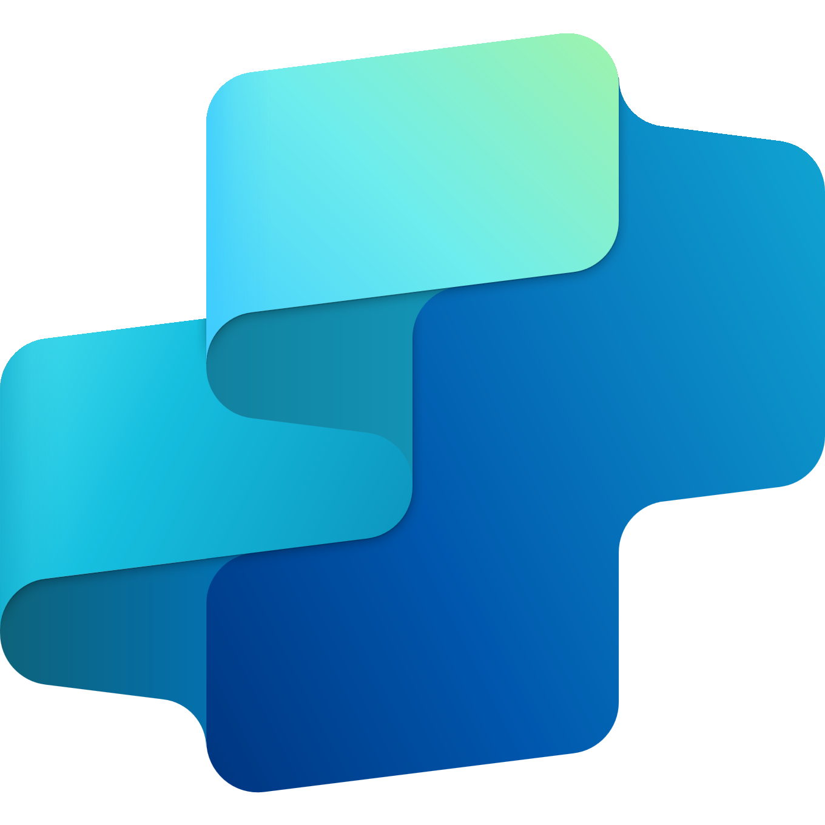
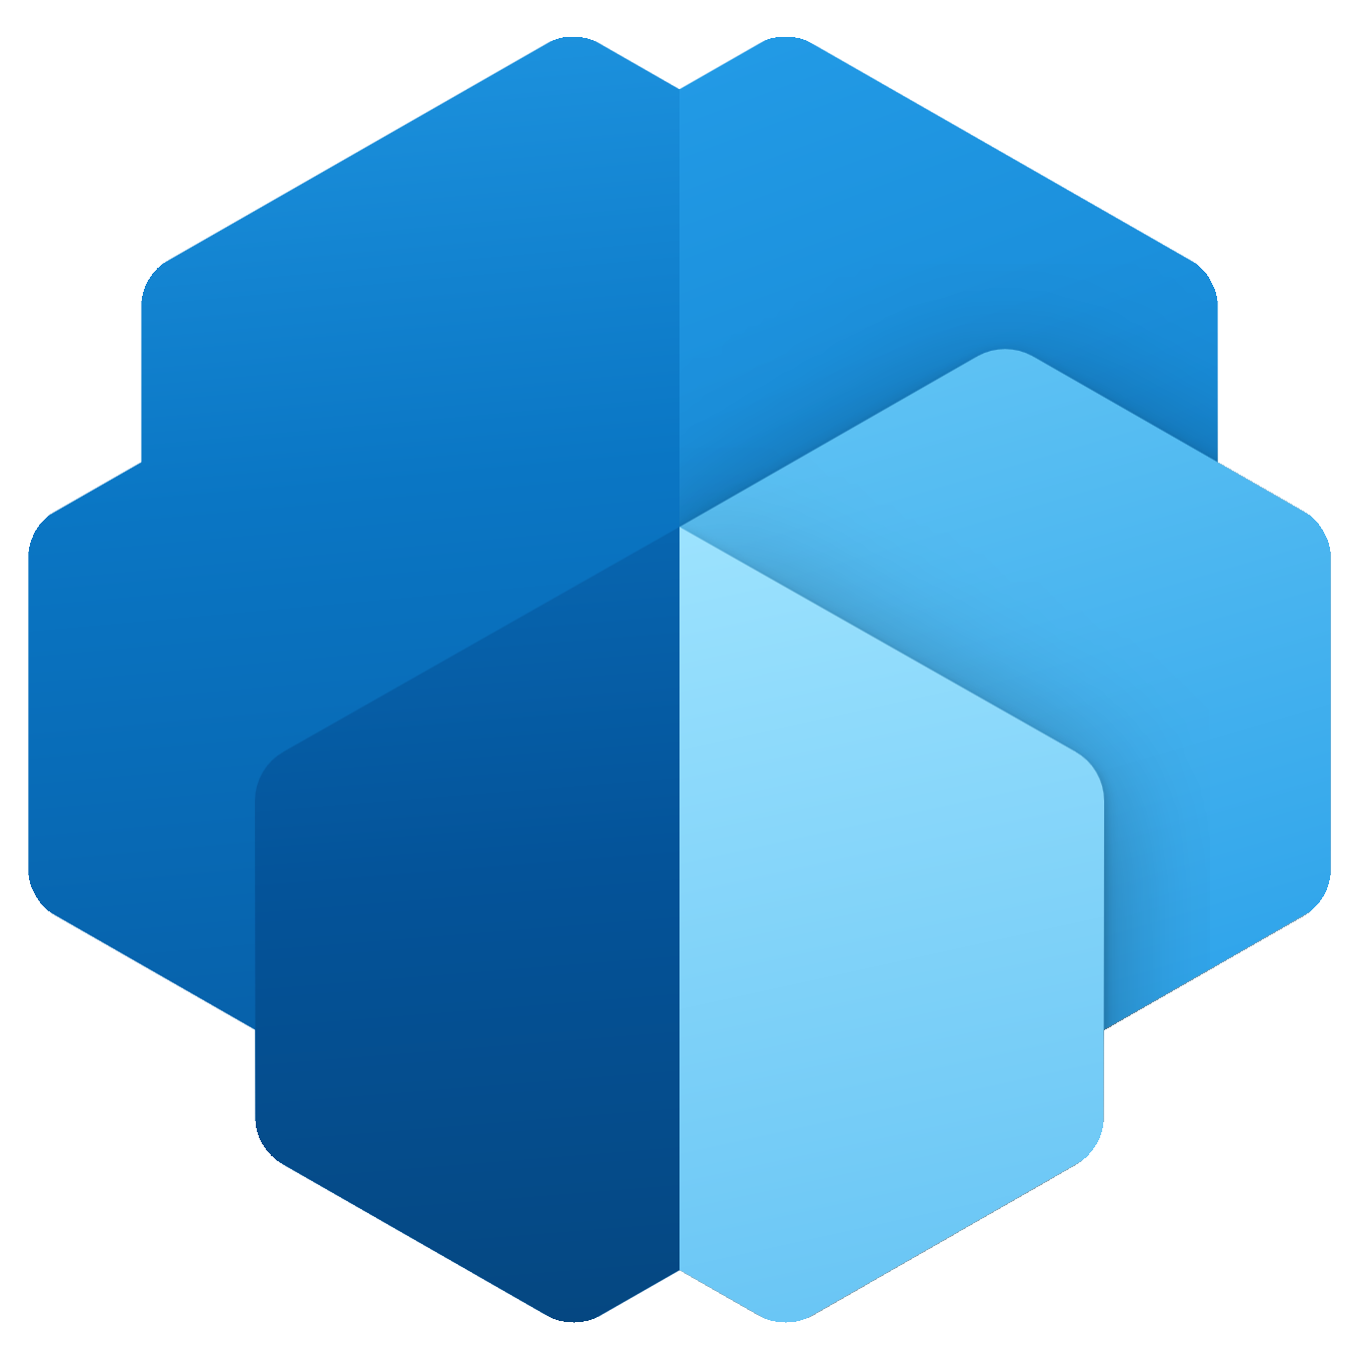
































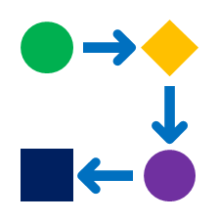













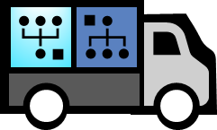





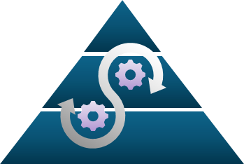


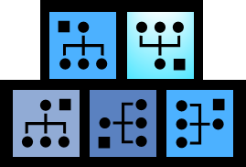
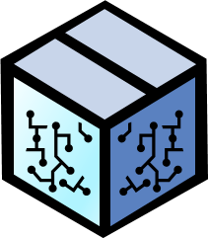
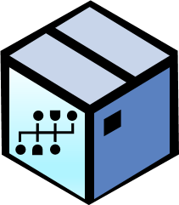




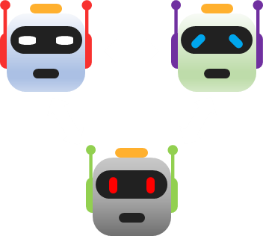


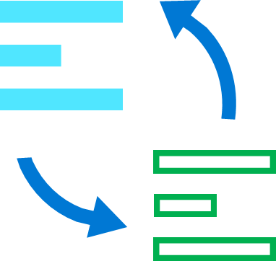

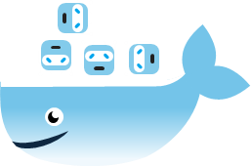




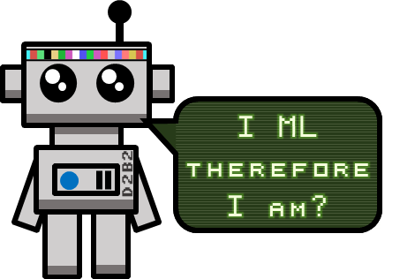


Microsoft AI Ecosystem
Use
Copilots
Extend Copilot reach using Plugins
Prompt Toolkit
Other AI enabled experience or process
Unofficial conceptual view of AI services and resources used to incorporate AI technology into organizations to achieve more with less.
Bing Integration
GitHub Copilot
Health, Finance, Retail and Industrial AI
Copilot experiences for Apps and Services
github.com/Pokeystuff/MSAIEcosystem
Copilot Development Stack
Connect AI to your data and build new AI and AI enabled experiences.
Your Data
Power Platform Connectors
(1000+)
Low-code
Power Platform
Copilot Studio
AI Builder
Other Apps and Services
Clouds
Custom Data
Data Lakes, Storage, Databases
On-premises
Build Copilots, AI enabled Apps and Business Automation without deep technical skills
Azure Cloud Services
RAG Pattern
Build and use Plug-ins
Retrieval Augmented Generation (RAG) grounds LLM responses by supplementing the LMM internal data with external data.
Microsoft Services
Connectors are the highways that allow information to travel to and from all the services in your technology ecosystem.
200+ Services
Build, run, and manage applications across multiple clouds, on-premises, and at the edge, with the tools and frameworks of your choice.
Copilot for Azure
Orchestration
SharePoint, Outlook
Teams, Power BI, OneDrive, Viva, Sales, Marketing, Finance and More…
Prompt + Knowledge → Response
App Service
Query → Knowledge
Azure AI Studio
Azure AI Services
Azure Machine Learning
Gen AI LM
Azure AI Search
Unified interface for Azure AI and ML solution management
Leverage AI in your organization without the need for data science skills using pre-created AI models
Build, fine-tune, and train custom AI and ML models grounded on your own data
Files, Databases, Lakes, Docs, Images
Dataverse
Fabric
OneLake
Create deep customised solutions with more technical control and operational management
Data Sources
Build
GPT LLMs
Whisper
Azure OpenAI Service
DALL-E
Assistants
Auto ML
MLOps
Prompt Flow
Notebooks
Azure Arc Hybrid and Multi-Cloud
On-Premises Data Gateway
Risk & Compliance
Unified Data Governance
Full dev control over the app and model behavior, higher fidelity data and feature integration
Grounding and Tuning
Provisioned Throughput
Data Privacy
Azure Integration Services
Data Science Virtual Machines
Microsoft
Purview
Compute Management
Responsible AI
Insights & Dashboard
Pipelines
Identify data risks, prevent data loss and manage regulatory requirements.
manage and govern on-premises, multi-cloud, and software as a service (SaaS) data
AI-powered information retrieval. Combine LLMs with heterogenous data for diverse application experiences.
ML Flow
Azure Marketplace
Azure Advisor
Explore
Compare
Evaluate
Improve
Safety
Azure AI Search
ML and AI Models
Data Sets and Models
Microsoft Research Open Data
Azure Open Datasets
Planetary Computer
Industry Data Models
Vision
Content Safety
Access and develop and train classic AI and Machine Learning models. Small, Medium and Large models. Generative AI, Language, Vision, Audio and Industrial models.
Integrate
Test
Review
Deploy
Monitor
Frameworks, Toolkits and SDK
Speech
Document Intelligence
Model as a Service
ONNX Runtime
Semantic Kernel
AutoGen
Bot Service
Immersive Reader
State
Memories
Side Effects
Plugins
Bot Framework
Data Science Toolkit
Responsible AI Toolbox
HAX Toolkit
Microsoft AI Value Accelerator (MAIVA)
Language and Translation
Video Indexer
Model Catalog
Custom / BYO
Vendor Pty
Opensource
AI UX
Copilot
Models
OpenAI & Azure AI Models
Open-source collection of proven ML and AI accelerators, enabling automation of commonly repeated development processes.
Learn about AI
Azure Spatial
Azure AI Containers on-premises
Easily build agents that can call your existing code. As a highly extensible, lightweight SDK, you can use Semantic Kernel with models from OpenAI, Azure OpenAI, Hugging Face, and more.
Develop LLM applications using multiple agents, LLMs and humans, that converse with each other to solve tasks.
A collection of libraries, tools, and services that let you build, test, deploy, and manage omnichannel bots.
Tools providing model and data exploration and assessment user interfaces and libraries that enable a better understanding of AI systems
For teams building user-facing AI products to conceptualize what the AI system will do and its behaviours. Use early in design process.
Responsible AI
Microsoft AI Blog
Global Infrastructure
Datacenter
GPU & AI Silicon
CPU
IO
Network
Circular Centers
Sustainability
Created by Dean Corcoran
End to end systems optimization
V1.51. Not an official Microsoft resource. All trademarks are property of their respective owners

